Slide 1
Node.js and the Windows Azure platform
Aidan Casey
Solutions Architect , MYOB

Slide 2
About Me…
solutions architect at MYOB
C#.NET, ASP.NET, WinForms

Slide 3
Session objectives
Introduction to node.js
Explain event-driven, non-blocking I/O processing
NPM (node package manager)
Build and publish a simple chat room application to azure
Tooling – editors , debuggers, unit testing

Slide 4

What is node.js
Open source project started in 2009
Server side technology for building scalable network programs.
Executes server side JavaScript code using Google's V8 JavaScript engine
Asynchronous architecture - pure evented I/O with non blocking infrastructure , everything executes on a single thread
Very popular amongst the developer community, large ecosystem of open source modules has emerged
Many hosting options – Azure, AppHarbour, Heroku, NodeSter.com(EC2,Rackspace,GoGrid!)

Slide 5
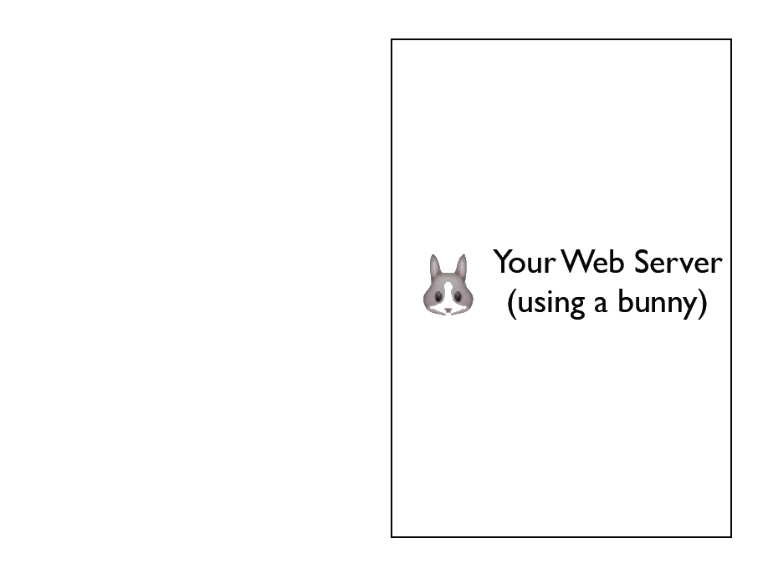

Slide 6
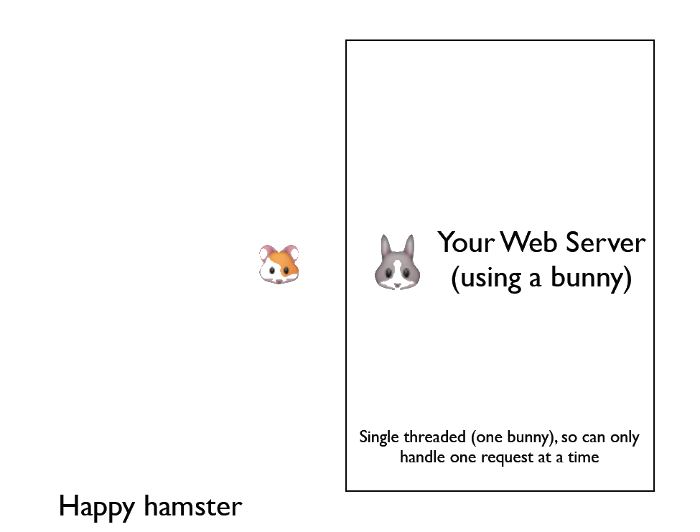

Slide 7
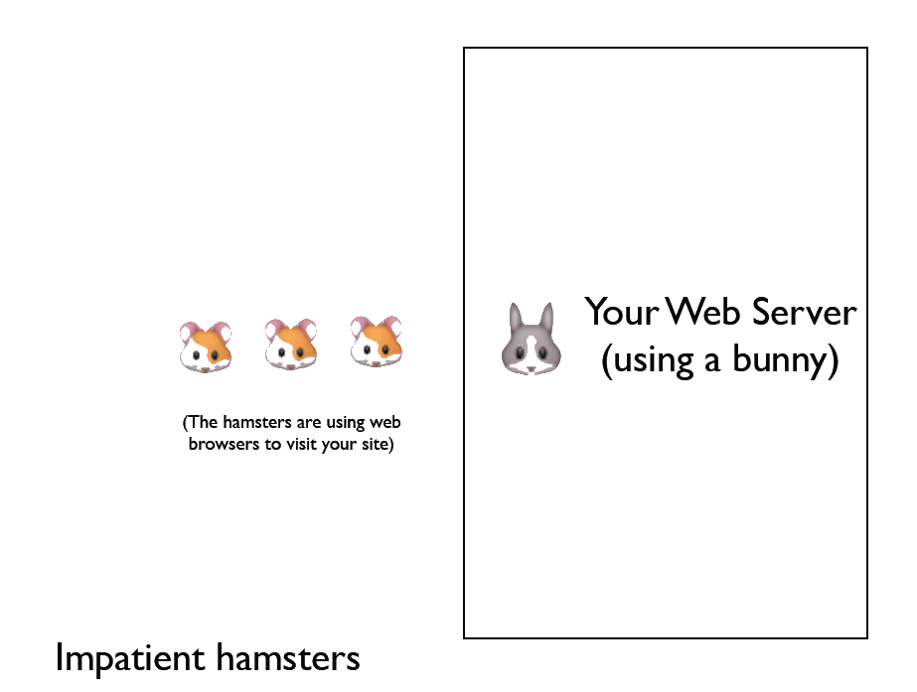

Slide 8
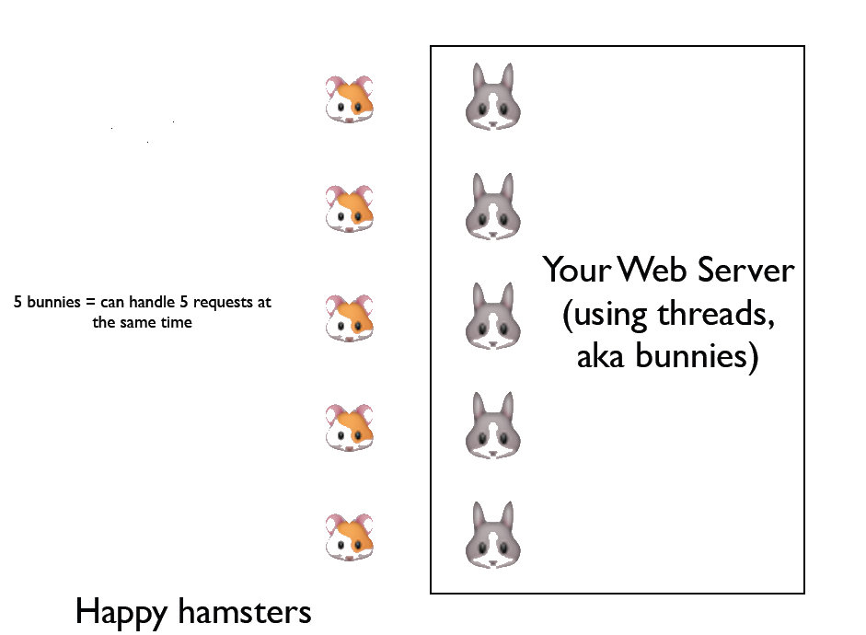

Slide 9
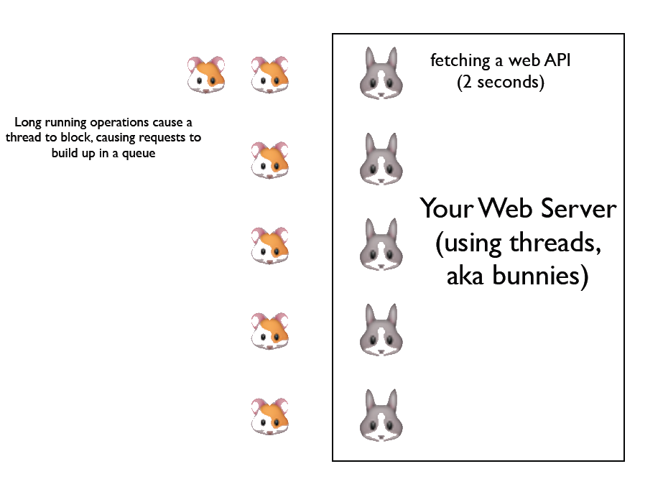

Slide 10
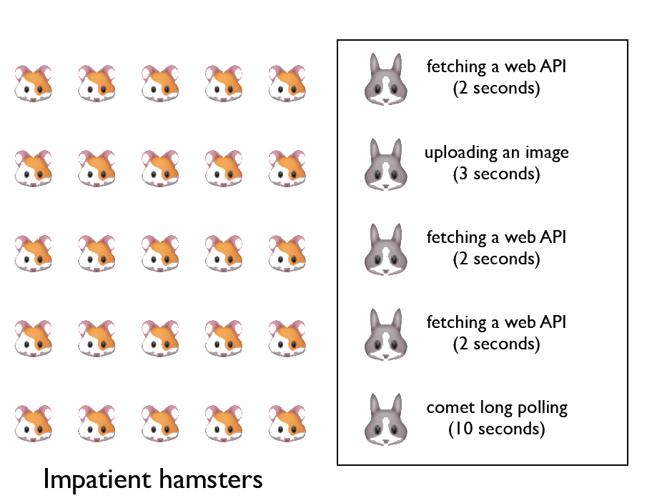

Slide 11
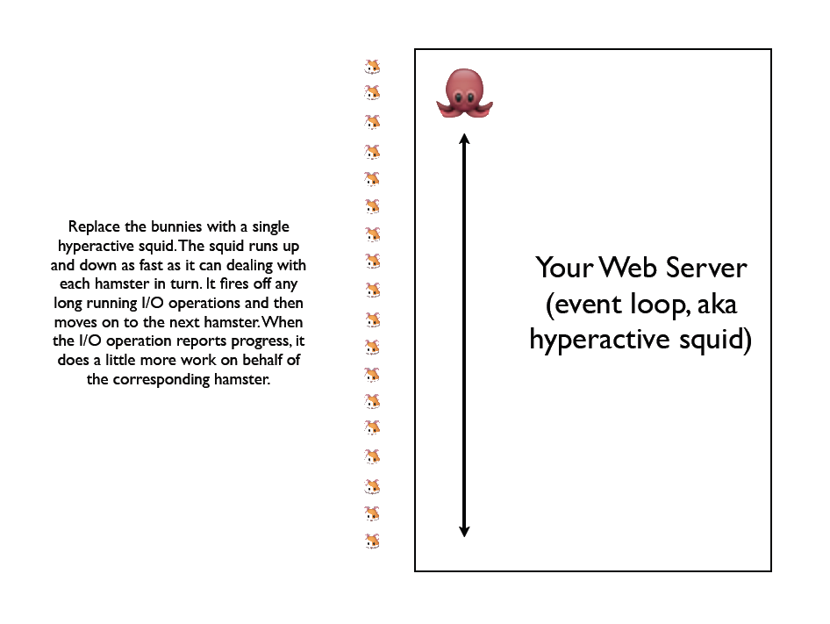

Slide 12


Don’t Block!
Since the Event Loop runs on a single thread you must avoid blocking calls at all times
Bad code snippet….
Good code snippet….

Slide 13
Why JavaScript?
Include fact that functions are first class objects !
http://nodetuts.com/pdf/handson-nodejs-sample.pdf

Slide 14
NPM node package manger
JavaScript closures run on different threads from event loop
Mention joyet and Ryan ?
Only uses 1 core .. Need to run other stuff to get multi core

Slide 15
Hello World!
Build a http webserver in 5 lines of code !!!

Slide 16
Thanks for listening!
email aidancasey@gmail.com
LinkedIn http://www.linkedin.com/pub/aidan-casey/2/a71/353

Slide 17
Demo building simple chat client and deploying to azure

Slide 18
Tools
IISNODE
DEBUGGING
POWERSHELL..
Cloud9ide – built purely on node
Node more active followers than jquery…

Slide 19
References
Evented I/O explained ( courtesy of Simon Willison)
http://www.slideshare.net/simon/evented-io-based-web-servers-explained-using-bunnies

